Slide 1
Cougcoin Wallet
Team:
Rushabh Shah, Harsh Tyagi ,Prashant Athaluri, Sanjita Bhavirishetty, Eshwar Pilli

Slide 2
Motivation
Centralized Bodies called as banks
Market manipulation
Decentralizing the market
High Infra-cost
Notes:
Because of centralization, power rests in the hands of
few individuals where manipulating data can be done easily. We have seen that many big,
centralized institutions were brought to trial because of data leaks and manipulations. This is where
the blockchain has an upper hand and it can solve the centralization problem because the core
concept of blockchain is that all the applications are decentralized. That means data manipulation
is impossible.
Moreover, the infrastructure cost can be brought down if we use decentralized applications.

Slide 3
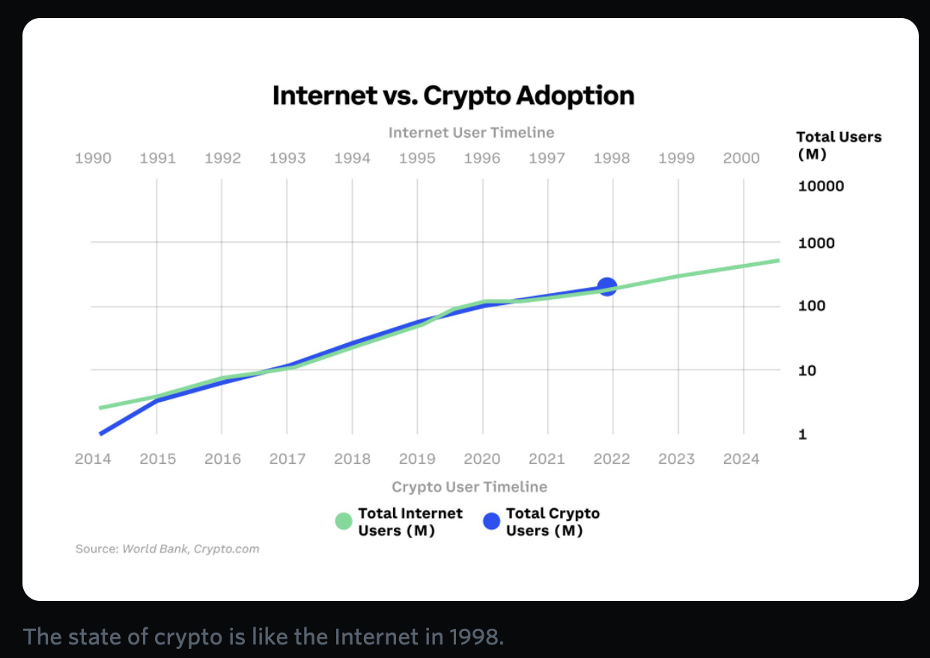
Design Problem
Exchange experience & Onboarding
Wallet Experience
Web3 guidance & curation
Notes:
Exchange experience & Onboarding As hundreds of millions of people interact with crypto for the first time, it's very likely that their first experience will be with a centralized exchange where they can exchange their local fiat currency for their first Bitcoin, Ethereum, stablecoin or other crypto asset. There's lots of responsibility and opportunity here to set new users up for success.
Wallet experience For some, just holding crypto assets may be enough, but many will be drawn to all that web3 offers from various dApps to NFTs and more. A crypto wallet is the passport to web3 and making it clear how to set one up, become familiar with connecting to other services, dealing with transactions and more will be a key experience to get right.
Web3 guidance & curation This is the discovery phase for slightly more advanced users that are now asking "What can I do with my crypto?" There are opportunities to help people discover what exists, what is safe to use and guide people along the way. It's 1998 and people rely on AOL or the Yahoo! homepage to show them what's out there. What's the curated search engine for crypto?

Slide 4
Prospective Users
“For the students, by the students”
WSU Students.
WSU Faculty.
WSU Dining services.
Notes:
The primary prospective users will be WSU students who can connect their decentralized wallet
to the application tool to check their wallet status, total balance, transact cryptocurrency. Also, any
item can be purchased by sending/receiving coug coin (cryptocurrency). Each user/student can see
their transaction history on how and where they spent their coug coin. So, our application tool will
act as a collective platform for all operations of cryptocurrency at WSU.

Slide 5
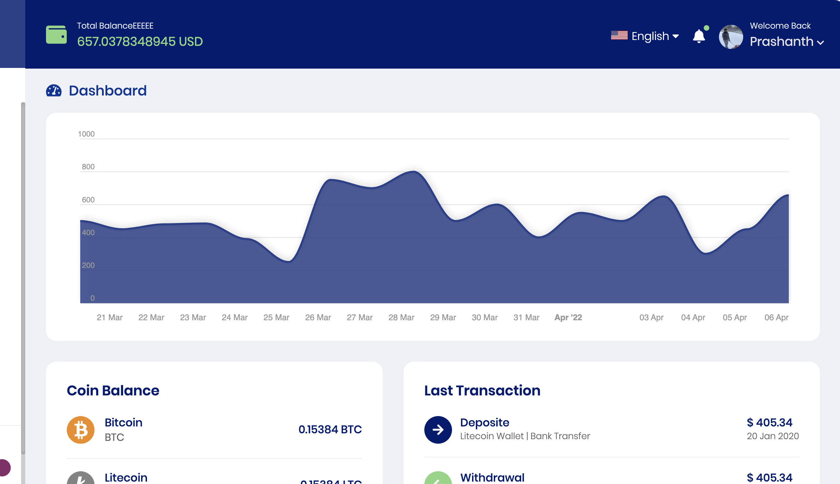
Proposed Solution
Better Onboarding Experience
Easy to use Wallet
One wallet to manage all.

Slide 6
Related Work
CoinBase
Electrum
Exodus
Notes:
Pros
User-friendly interface that is easy to navigate
Supports more than 500 cryptocurrency assets
Multi-signature and 2-factor authentication support
Backed by a reputable exchange that is able to recoup lost or stolen assets
CONS
Similar security issues and weak points as other hot storage alternatives
Only available on mobile and tablet devices (except for Chrome extension)

Slide 7
Features / Core Tasks
Balance of the account on a particular day?
Transferring crypto coins to your friend’s wallet.
Transfer/Exchange coins in your own wallet.
Changing the profile details.
Changing password.
Check different coin balances.
Check the transaction exchange history.
Copy your Cougcoin and different crypto coins wallet address.

Slide 8
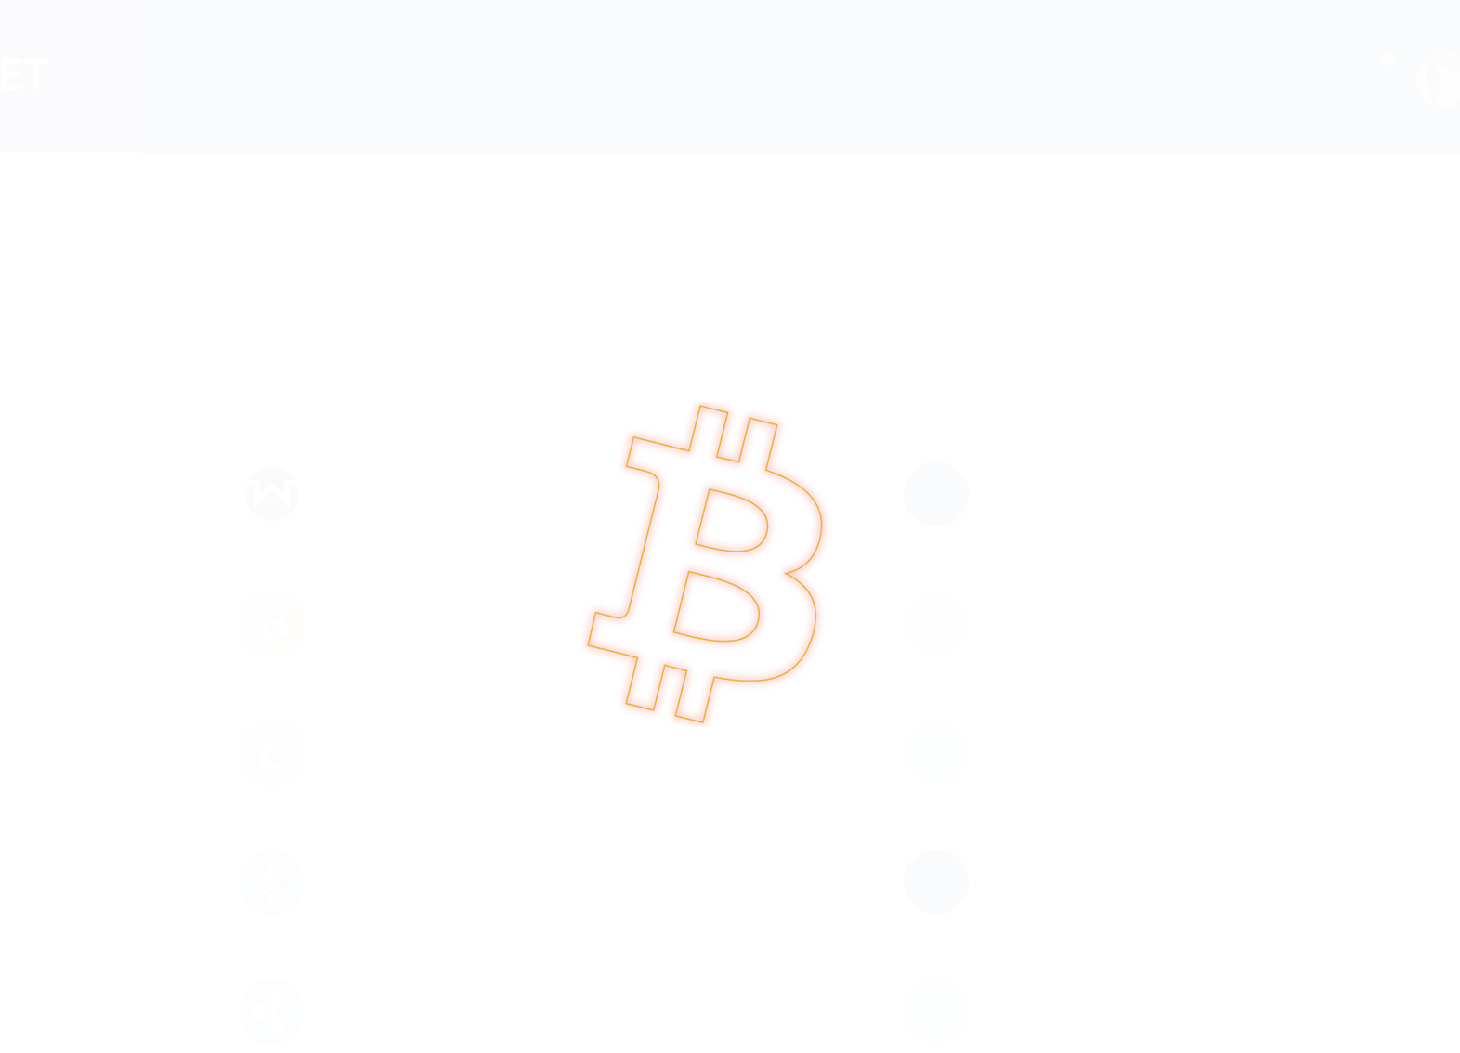
Splash Screen

Slide 9
Task1: Balance of the account on a particular day?

Slide 10
Task2: Transferring crypto coins to your friend’s wallet.

Slide 11
Task3: Transfer/Exchange coins in your own wallet.

Slide 12
Task4: Changing the profile details.

Slide 13
Task5: Changing password.

Slide 14
Task6: Check different coin balances.

Slide 15
Task7: Check the exchange history.

Slide 16
Task8: Copying your coin wallet address.

Slide 17
Early Data Gathering
Research Questions
Participants(number and relevant background)
Contextual inquiry sessions (process and environment)
Themes and findings
Core software requirements

Slide 18
Research Questions
How open is the user to trying out new payment methods?
How much experience does the user have with cryptocurrency?
Do users consider cryptocurrency as an investment option?
What frequency does the user transact over a blockchain?
Is the user ready to use cryptocurrency for the on-campus transaction?

Slide 19
2 – Participants (number & Relevant background)

Slide 20
3 - Contextual inquiry sessions

Slide 21
4– Themes and findings

Slide 22
5- Core software requirements

Slide 23
Participants
5 Participants
Participants are mostly WSU students working as Research Assistants, Technical Assistants and PhD students
Different Background: Software engineer, PhD in Mechanical Engineering, Undergrad CS student.

Slide 24
Usability Study 1

Slide 25
Usability Study 2

Slide 26
Usability Study 3

Slide 27
Usability Study 4

Slide 28
Study Procedure
Conducted usability study on Zoom
Performed analysis and developed application after conducting the study.

Slide 29
Usability Problem 1
Problem: The user found it difficult to transfer from USD to Coug coin.
Severity: Severity 2, Scope 2
2 participants faced this problem.

Slide 30
Usability Problem 2
Problem: Not able to copy wallet address
Severity: Severity 2, Scope 1
1 participant faced this problem

Slide 31
Usability Problem 3
Problem: The user found it difficult to transfer from one coin to another in the same wallet.
Severity: Severity 2, Scope 1
2 participants faced this problem.

Slide 32
Usability Problem 4
Problem: Bridge the knowledge gap.
Severity: Severity 2, Scope 2
All participant faced this problem

Slide 33
Propose Design Changes

Slide 34
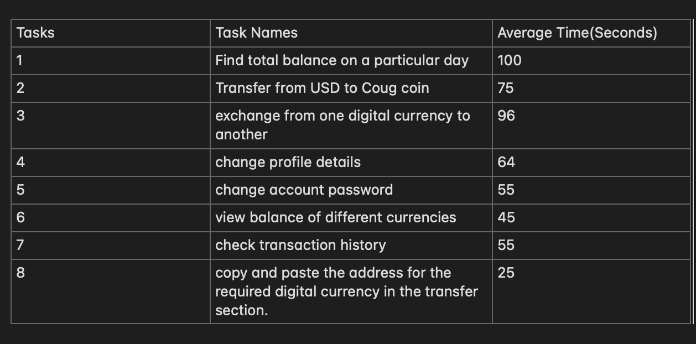
Average Task Timings

Slide 35
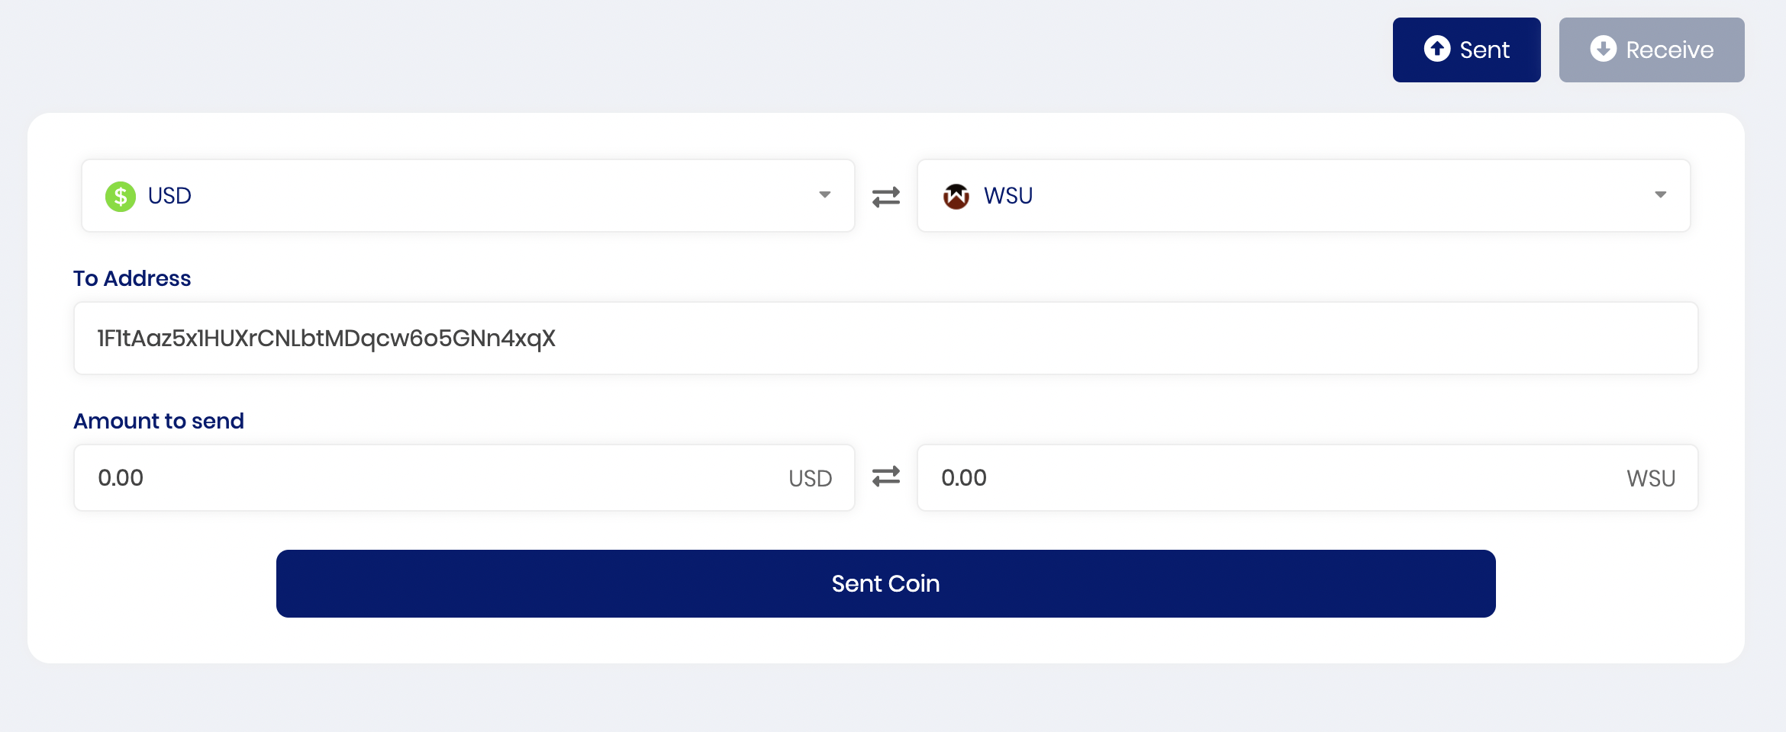
Usability Problem Design change 1
Problem: The user found it difficult to transfer from USD to Coug coin. Previous Design:

Slide 36
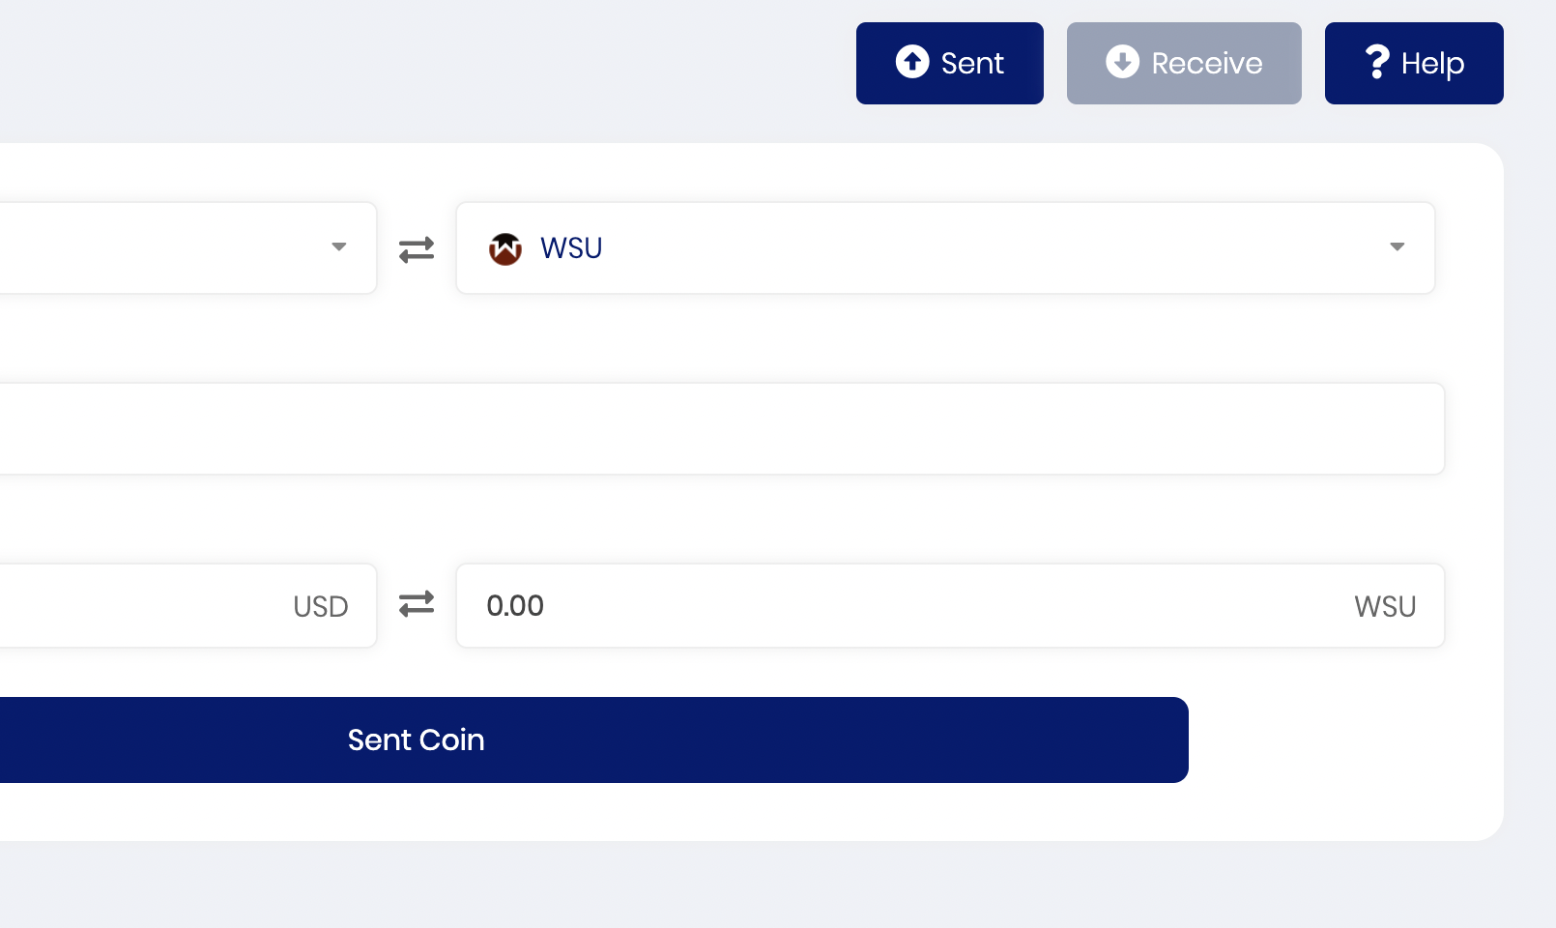
Usability Problem Design change 1
Problem: The user found it difficult to transfer from USD to Coug coin. Updated Design:

Slide 37
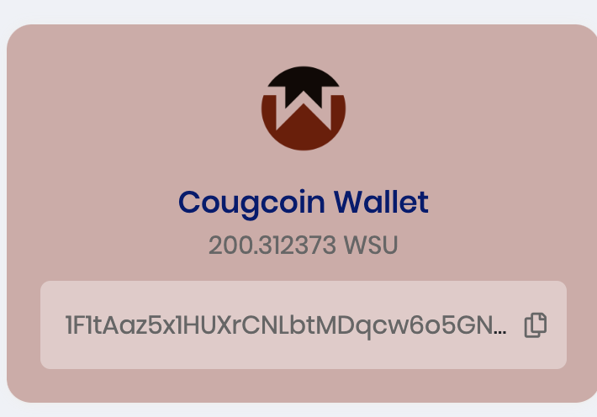
Usability Problem 2
Problem: Not able to copy wallet address
Previous Design:

Slide 38
Usability Problem 2
Problem: Not able to copy wallet address
New Design: No change in the design was needed, Users were able to understand the copy button easily but the backend functionality for the copy was not working. The backend system was updated.

Slide 39
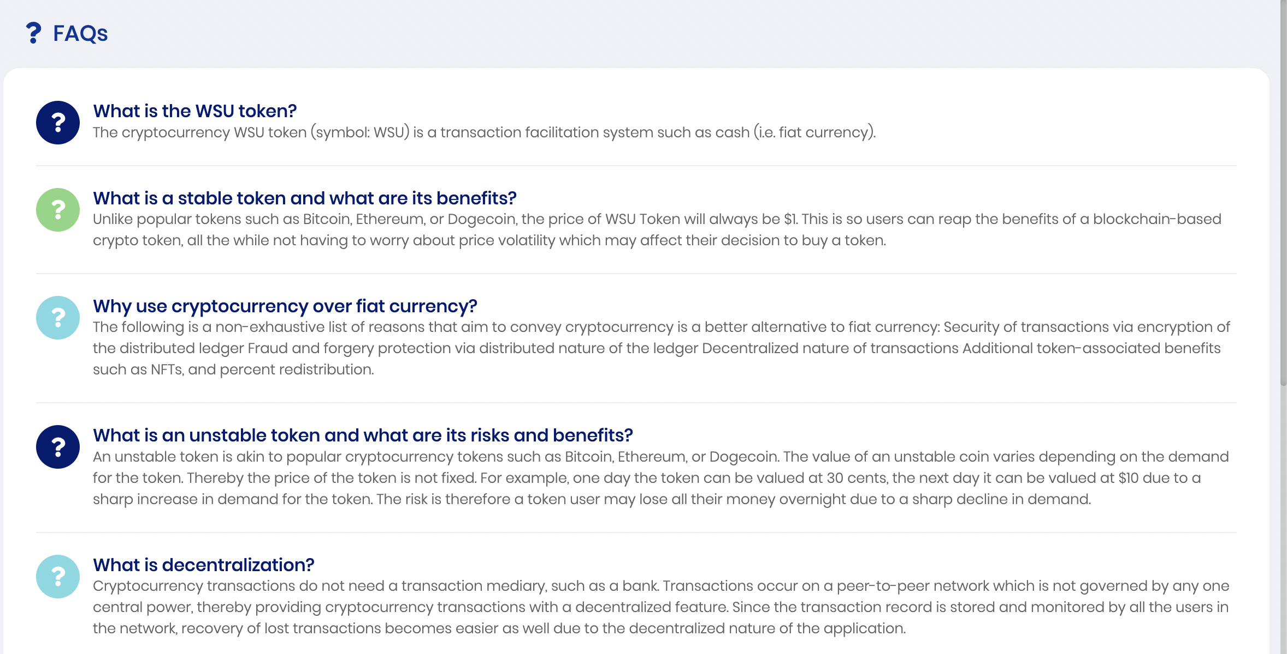
Usability Problem 3&4
Problem: The user found it difficult to transfer from one coin to another in the same wallet.
Notes:
All the participant faced the similar issues while transferring the coins to different wallets or their own wallet.
They were able to do it after certain hints.
This helps us understand that we need to bridge the knowledge gap for the target audience

